Slide 1


OPENNEXT WP2.2
Community health dashboard & preliminary user testing results↴
Pen-Yuan Hsing, University of Bath (UBA)

Slide 2
for example…
I want to find skilled contributors for my project
What’s a good project for me to contribute to?
Does the future of our project rely on one person?

Slide 3

Wikifactory
version control repository hosting platforms
GitHub logo, fair use
Notes:
Git was originally designed for tracking changes in software source code, but now many hardware projects use it, too.
The way git works is that…

Slide 4
metrics from metadata
3D CAD skills needed!
infer skillset from file types to help contributor match-making?

Slide 5
data mining
from open source hardware repository metadata

Slide 6
commit
who: Jean-Luc P.
when: 10:35 28 June 2022
what: lorem_ipsum.txt (add 2 lines) foobar.cpp (remove 3 lines)
commit
time
commit
commit
commit
Notes:
Each one of the records is called a “commit”. And for each commit, there is metadata on when the changes happened, and what the changes were.

Slide 7
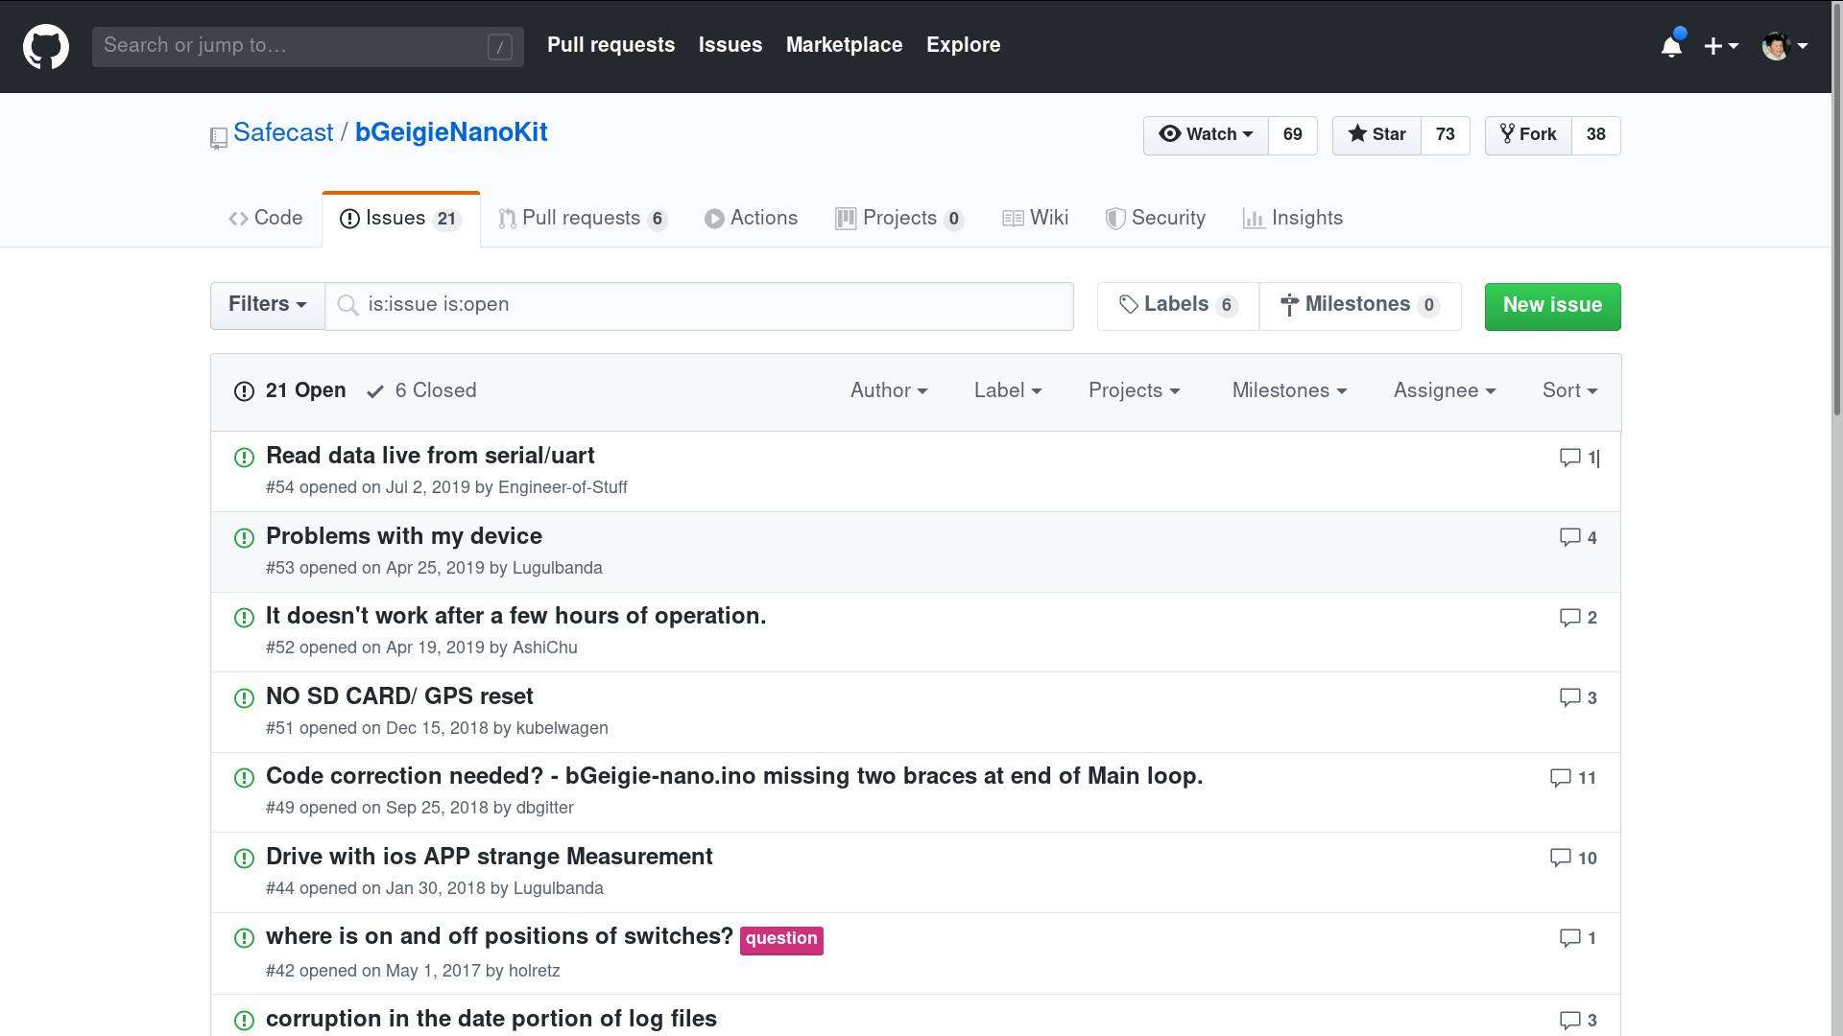
user interactions on GitHub/Wikifactory issues
Github issues page for bGeigieNanoKit screenshot, fair use

Slide 8
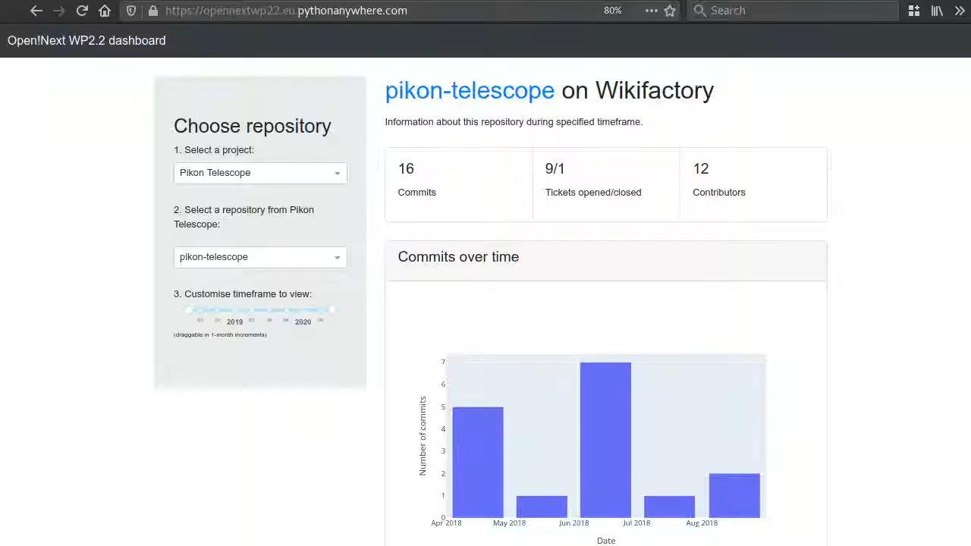

Slide 9
D2.3 demonstrator
Find indicators that are useful for real users
2021

Slide 10
requirements capture
with Wikifactory and WP3 collaborators

Slide 11
stakeholder types and their information needs
Project Owner
Direct Contributor
Indirect Contributor
Replicator
Founder of Similar Project
Researcher
Recruiter
Manufacturer
Educational User
Activity Level
Community Organisation
Contributor Profiles
Documentation
Popularity
Newcomer Friendliness

Slide 12
files editability
releases
file types
project skill tags
issue time to close
bus factor
user activity
standards compliance
50
contribution types
network graph
status indicators
user skill tags
GOVERNANCE file
license information
issue activity
citations
commit activity
downloads
multiple views
manufacturing metadata

Slide 13
file types
issue activity
commit activity
10
user skill tags
top
project skill tags
picks
manufacturing metadata
standards compliance
by Wikifactory
license information
files editability
multiple views

Slide 14
backend infrastructure
intermediary between Wikifactory and project repositories

Slide 15
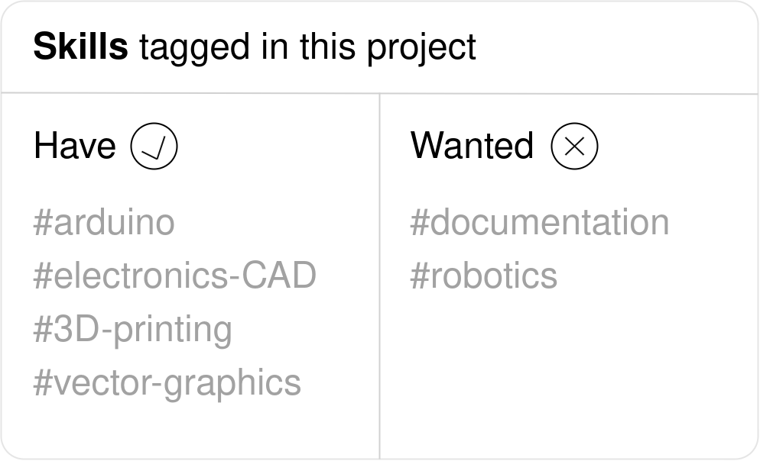
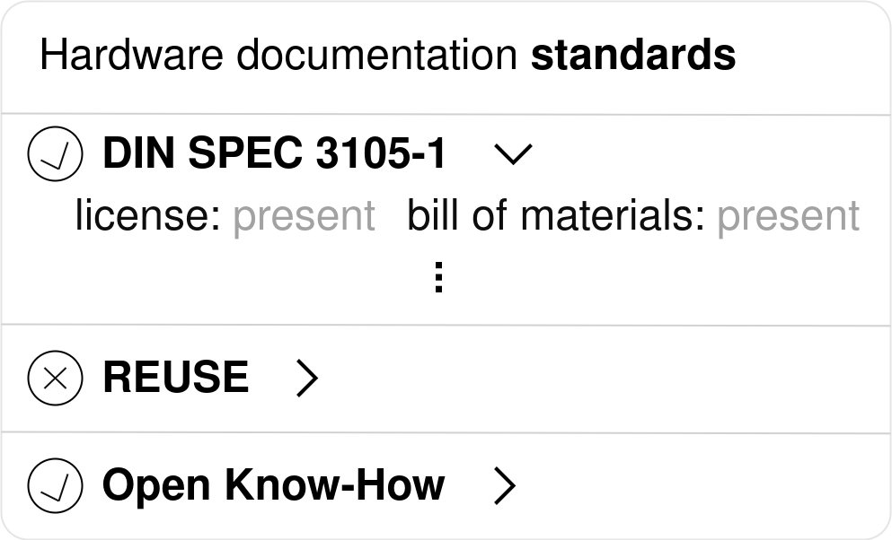
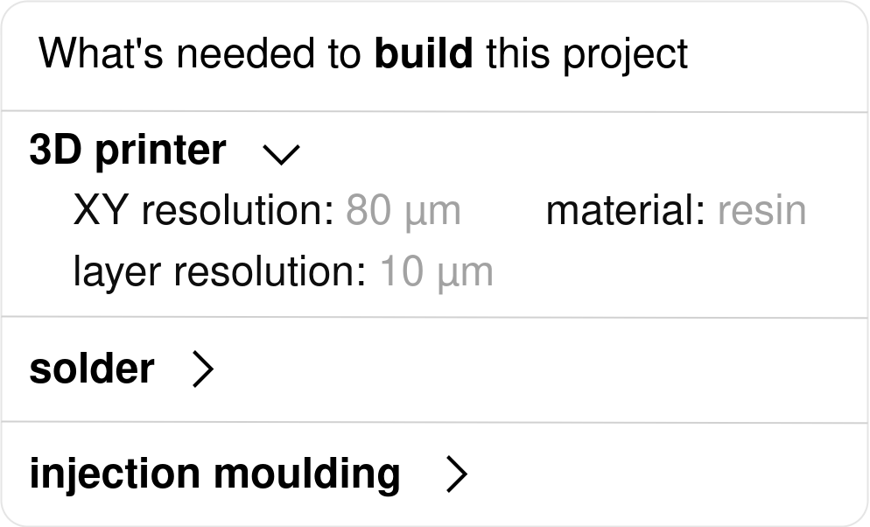
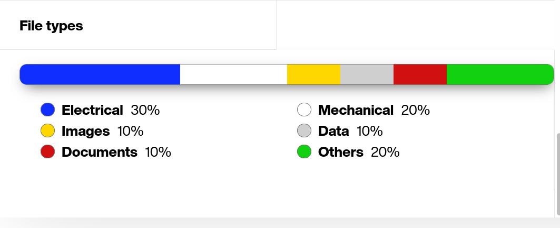
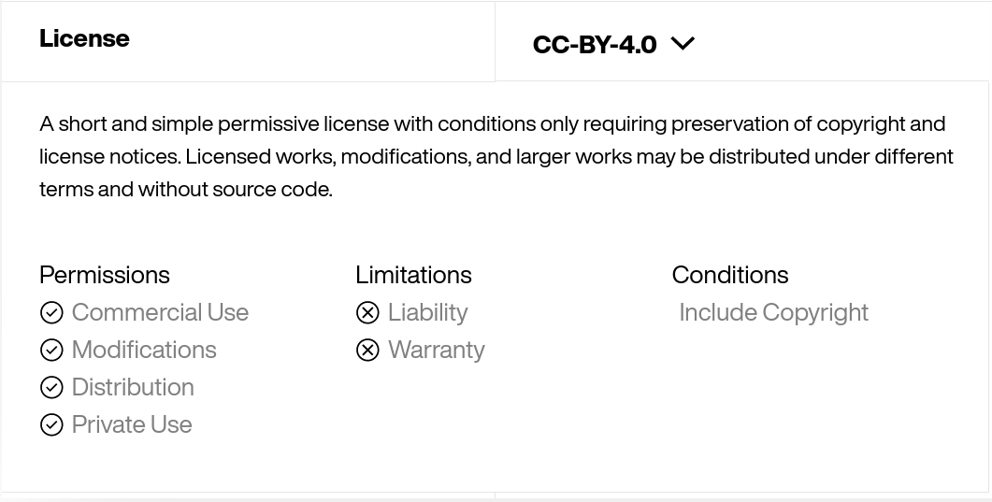
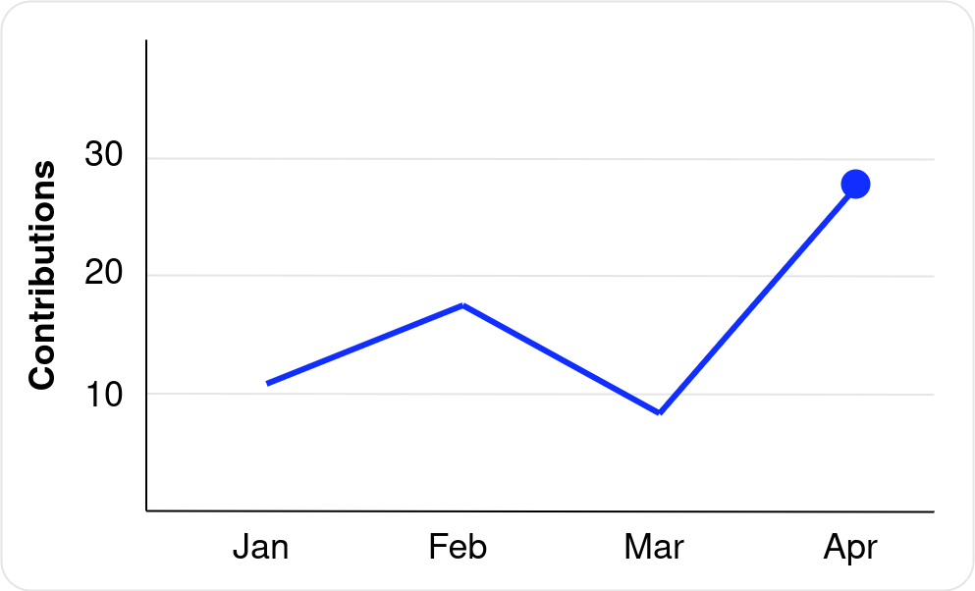
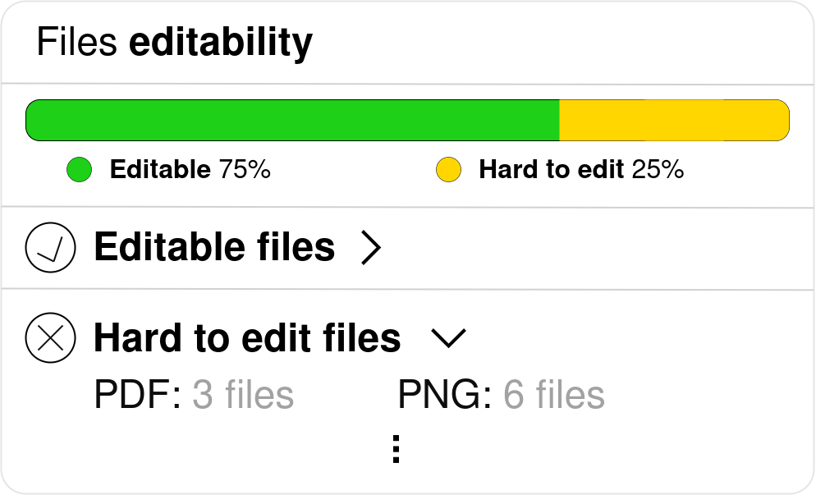
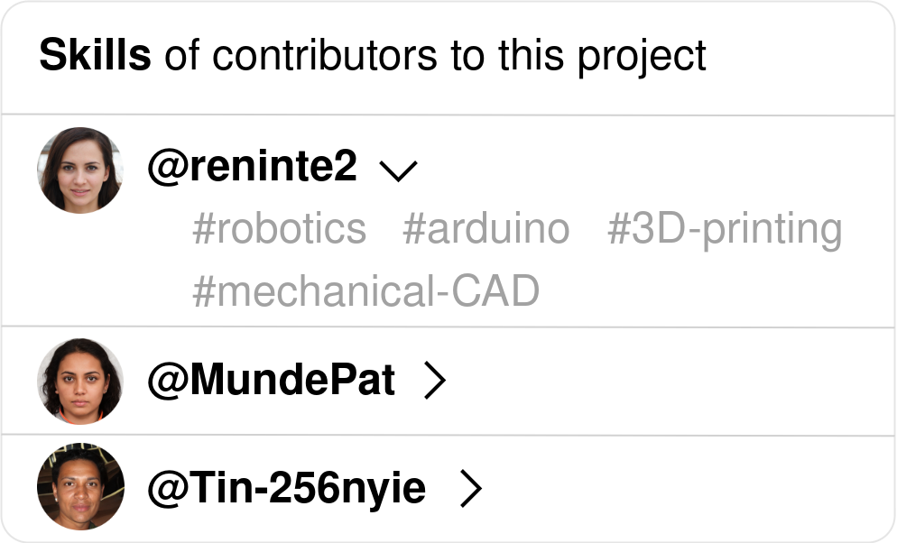
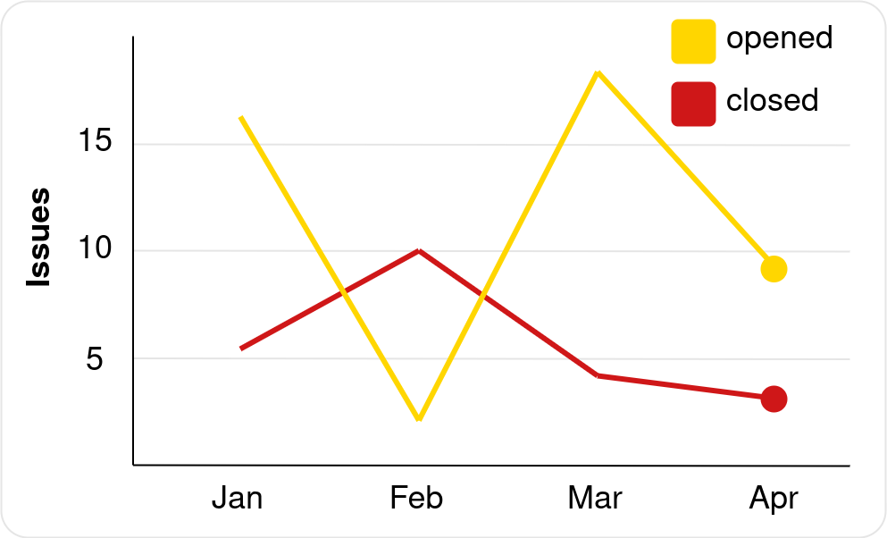
visualised each indicator

Slide 17
frontend example
demonstrate possible visualisations

Slide 18
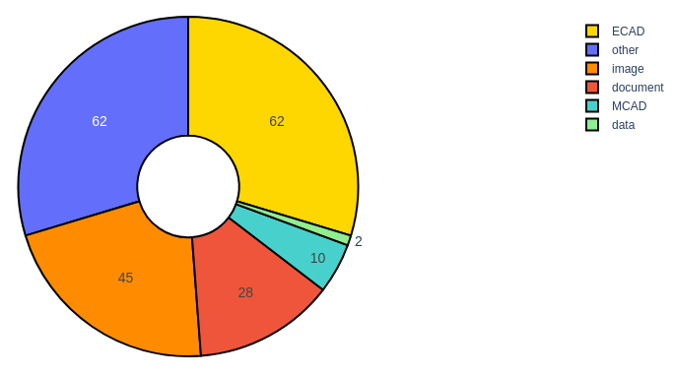
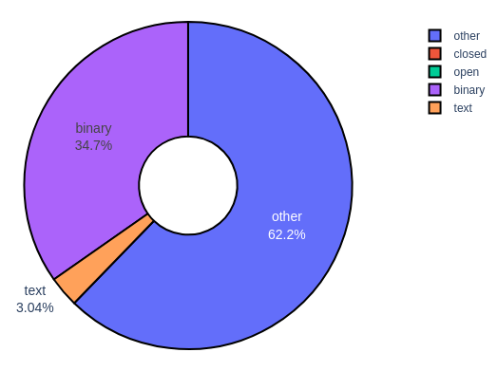
implementation flexibility

Slide 19
D2.5 demonstrator
2021
2022

Slide 20
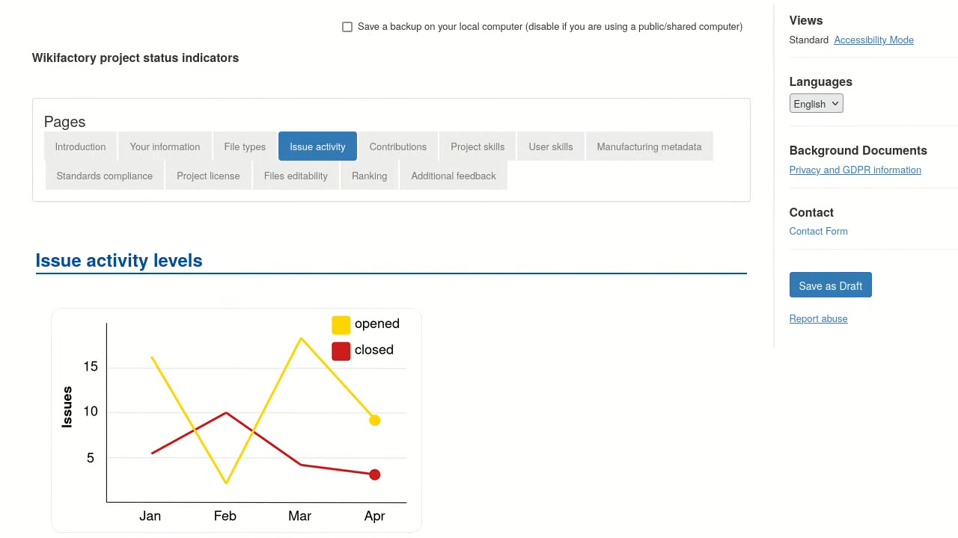
Wikifactory user survey to prioritise development

Slide 21
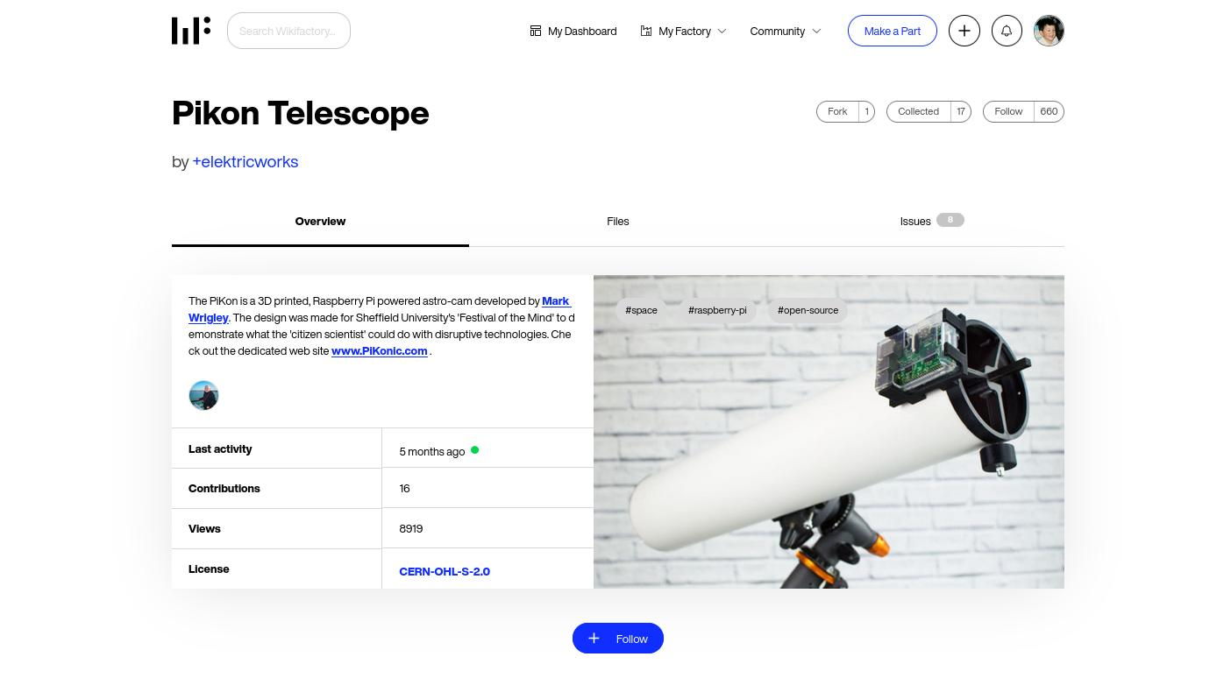
2
Implemented mid-2022
More in future steps…
What indicators to show on a Wikifactory project?

Slide 22
1. Add indicators to Wikifactory 2. Demonstrated cross-platform use
3. Projects can also self-host
D2.5 demonstrator
2021
2022
Continued stepwise development by Wikifactory beyond OPENNEXT

Slide 23

thank you
opennext.eu github.com/OPEN-NEXT/wp2.2_dev
supported by EU Horizon 2020 grant agreement 869984

